Slide 1

Module-IV Introduction to ARM Programming

Slide 2

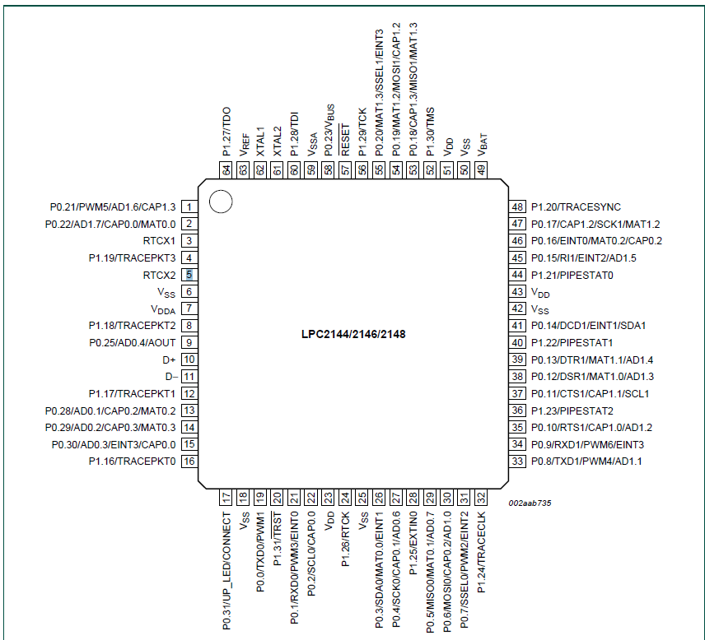
LPC214x Pin configuration

Slide 3
What is LPC2148 and GPIO
LPC2148 is a 32-bit Microcontroller based on the ARM7TDMI-S Family.
It is manufactured by NXP Semiconductors (formerly Philips) and is one of the widely used and highly successful ARM7-based Microcontrollers.
It is one of the best and easiest microcontrollers to work around for beginners in ARM-based microcontrollers
3

Slide 4
Features of the LPC2148 microcontroller
LPC2148 is a 32-bit microcontroller based on the ARM7 family (ARM7TDMI-S to be specific) and is available in a 64-pin LQFP Package (Low Profile Quad Flat Package).
It has an on-chip static RAM of 32kB and an on-chip flash memory of 512kB.
LPC2148 has an on-chip boot loader software that can be used to program the microcontroller using the feature of In-System Programming.
It also has the feature of in-Application Programming using which the user can program the microcontroller without using the boot loader software.
4

Slide 5
Features of the LPC2148 microcontroller
It has an embedded in-circuit emulator that helps in real-time debugging.
LPC2148 has two 10-bit ADCs (ADC0 and ADC1) of
Successive Approximation type.
It also has a 10-bit DAC of Resistor String type.
GPIO is the first thing we need to learn before starting its embedded programming as input/output pins are the only way to interface with the microcontroller.
GPIO pins can be used for driving loads, reading digital and analog signals, controlling external components, generating triggers for external devices.
5

Slide 6
Registers
Different registers used for configuring or controlling a pin of an ARM microcontroller.
In microcontrollers, pins are divided into different PORTS.
Usually a 32-bit microcontroller will have 32 pins per PORT (sometimes it may vary).
LPC2148 has 2 PORTS, P0 and P1. Each pin of these ports is named P0.0, P0.1, P0.2, P1.0, P1.2 etc.
6

Slide 7
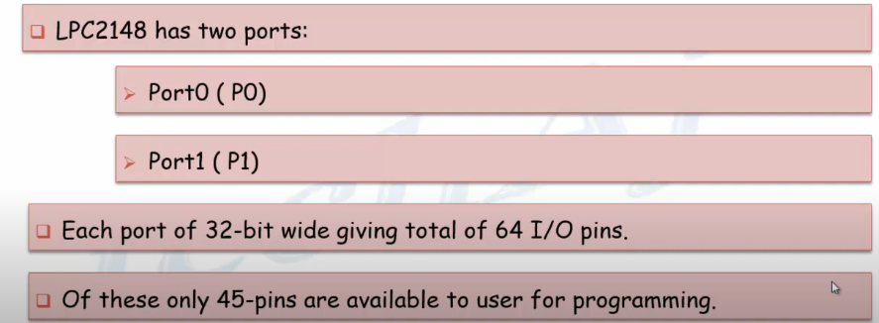
LPC 2148 I/O PORTS

Slide 8
Registers
LPC2148 has two IO ports namely PORT0 (P0) and PORT1 (P1). These two IO ports are 32-bit wide and are provided by the 64 pins of the microcontroller.
PORT0 is a 32-bit wide input/output port with dedicated direction control bits for each physical pin.
Out of the 32 pins, 28 pins can be used as general-purpose bidirectional I/O pins. Pin P0.31 is an output-only pin. Pins P0.24, P0.26, and P0.27 of PORT0 are not available.
PORT1 is also a 32-bit wide input/output port. In PORT1, pins P1.0 to P1.15 are not available and pins P1.16 to P1.31 are the available general-purpose input/output pins.
8

Slide 9
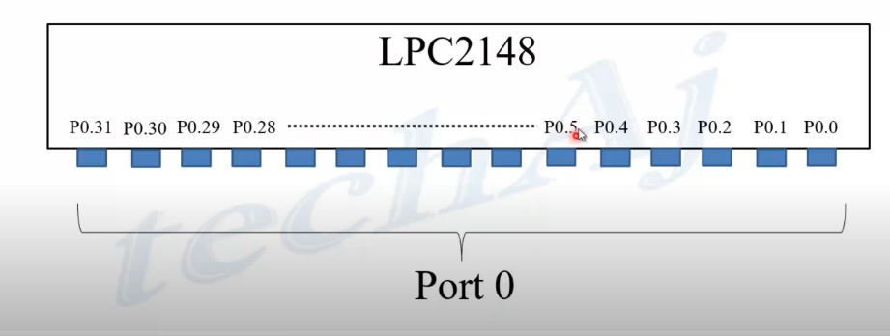
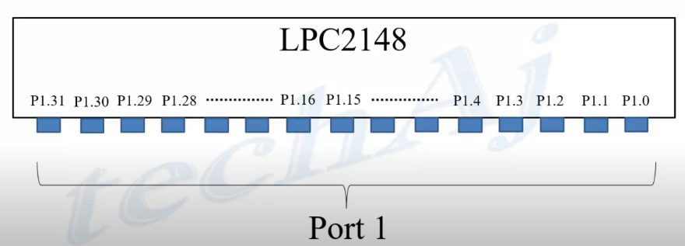
LPC 2148 I/O PORTS
9

Slide 10
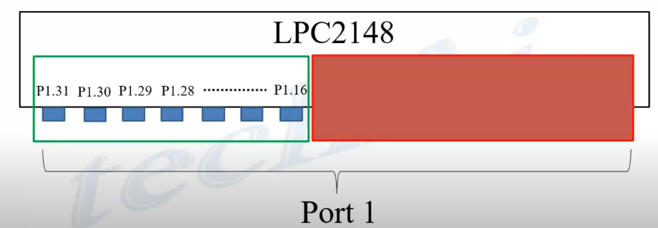
LPC 2148 I/O PORTS
10

Slide 11
Registers
Most of the pins in both the I/O ports of the LPC2148 have more than one function i.e. they are multiplexed with different functions.
Pin 19 of the LPC2148 has three functions namely P0.0, a general purpose I/O pin, TXD0, the transmitter O/P for UART0 and PWM1, and the pulse width modulator O/P 1.
Each pin can have a single function and the function can be selected with the help of three Configuration Registers which control the multiplexers to allow connection between the external pin and the on-chip peripheral.
11

Slide 12
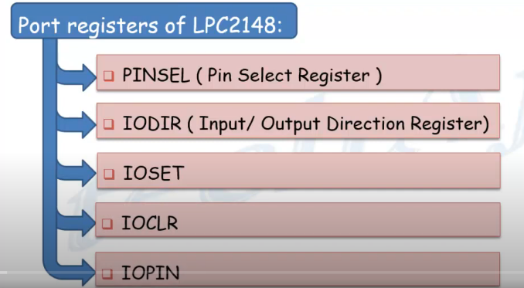

Slide 13
Registers
The configuration register is called PINSEL and is classified in to three registers: PINSEL0, PINSEL1 and PINSEL2..
These configuration registers are of 32-bit wide. Any pin on the LPC2148 can have a maximum of 4 functions..
in order to select one of the four functions, two corresponding bits of the PINSEL register are needed.
32-bit PINSEL register can control 16 pins with 2-bits to control each pin.
PINSEL0 controls PORT0 pins P0.0 to P0.15, PINSEL1 controls PORT0 pins P0.16 to P0.31 and PINSEL2 controls PORT1 pins P1.16 to P1.31.
13

Slide 14
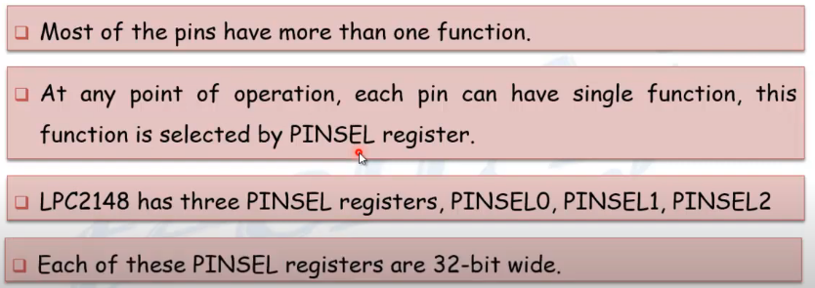
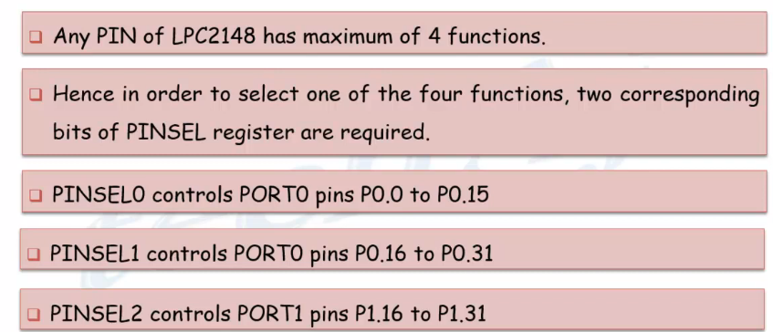
PINSEL
14

Slide 15
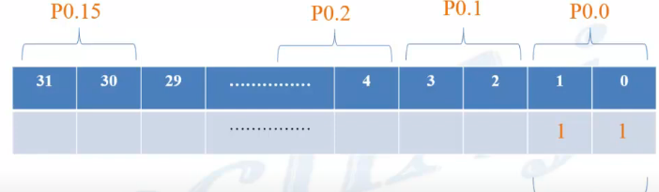
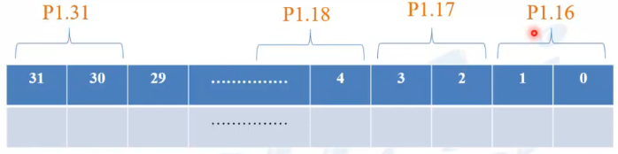
PINSEL0
15

Slide 16
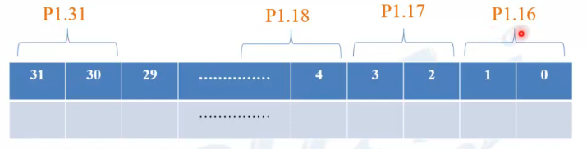
PINSEL1
16

Slide 17
Registers
PINSELx:
Most of the pins of an ARM microcontroller is multi-functional, every pin can be made to perform one of the assigned function by setting bits of PINSEL register.
17

Slide 18
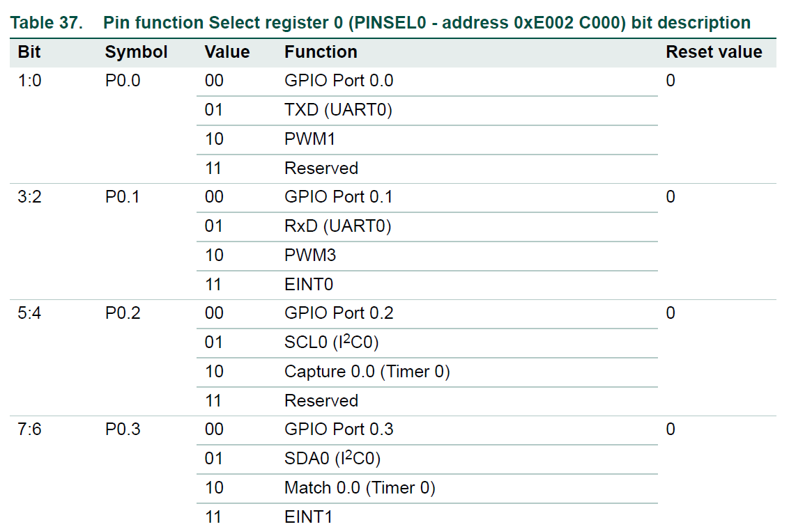
Registers
Pin function Select register 0 (PINSEL0 - 0xE002 C000)
The PINSEL0 register controls the functions of the pins as per the settings.
The direction control bit in the IO0DIR register is effective only when the GPIO function is selected for a pin.
For other functions, direction is controlled automatically.
18

Slide 19
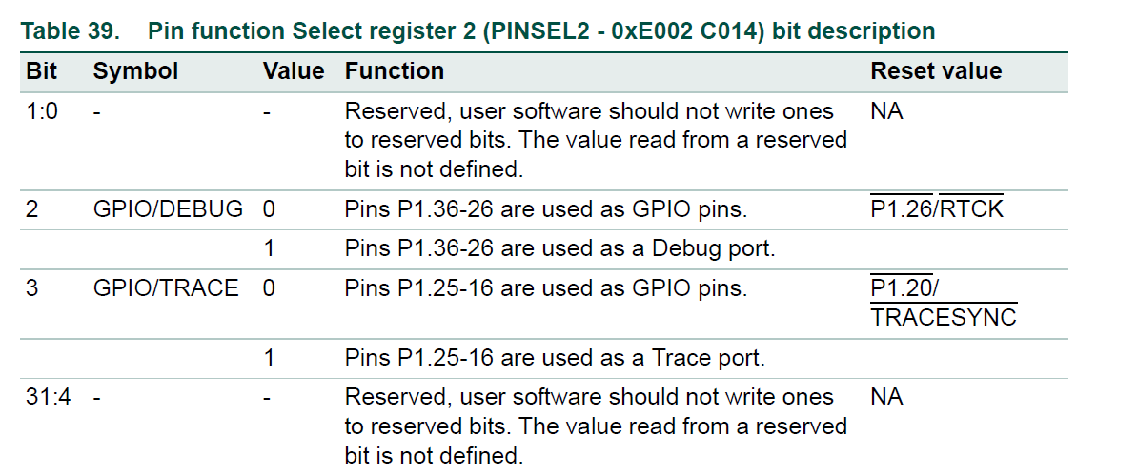
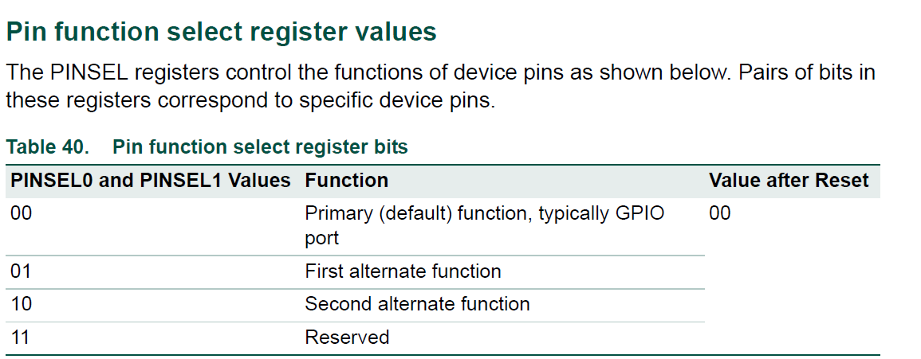
Registers
19

Slide 20
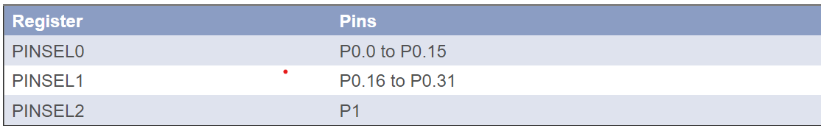
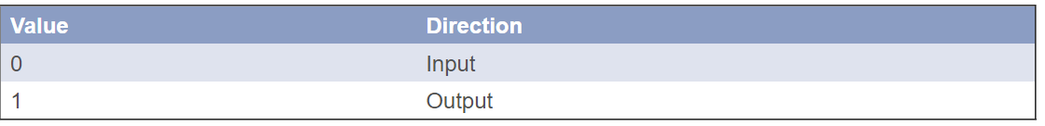
Registers
IOxDIR
This register is used to control the direction (input or output) of a pin, once is it configured as a GPIO pin (General Purpose Input Output) by using PINSELx register.
20

Slide 21
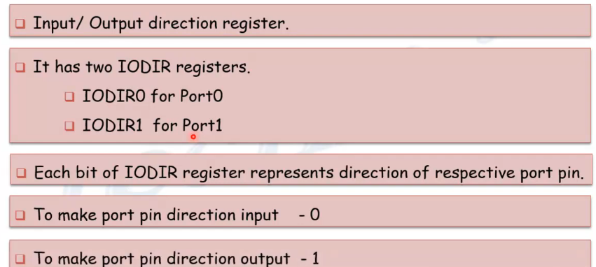
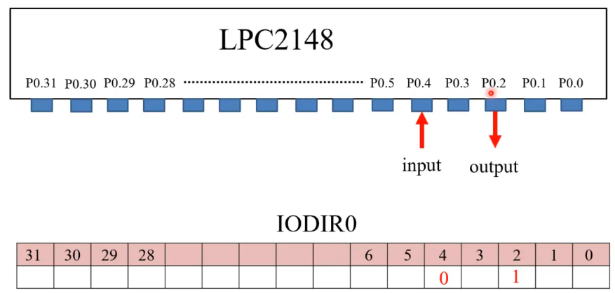
IODIR
21

Slide 22
Registers
IOxPIN
IOxPIN is GPIO port pin value register. This register is used to read the current state of port pins regardless of input or output configuration.
It is also used to write status (HIGH or LOW) of output pins.
IOxSET
IOxSET is GPIO output set register. This register is commonly used in conjunction with IOxCLR register described below.
Writing ones to this register sets (output high) corresponding port pins, while writing zeros has no effect.
22

Slide 23
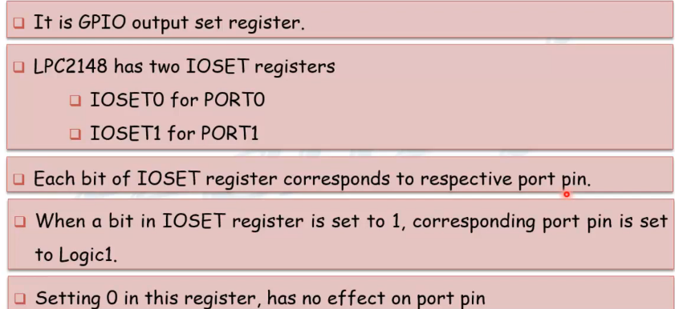
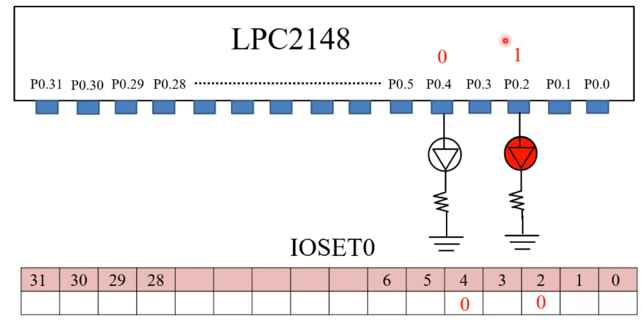
IOSET
23

Slide 24
Registers
IOxCLR
IOxCLR is GPIO output clear register. As mentioned above, this register is used in conjunction with IOxSET.
Writing ones to this register clears (output low) corresponding port pins, while writing zeros has no effect
24

Slide 25
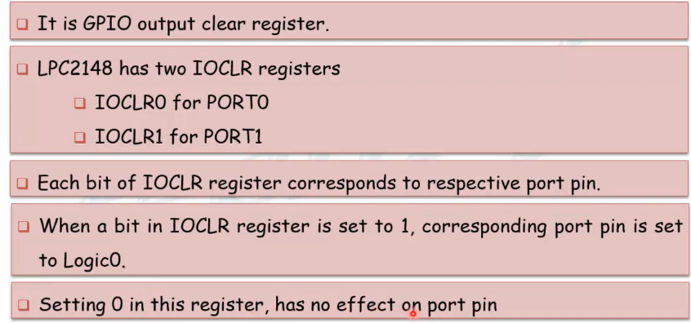
IOCLR
25

Slide 26
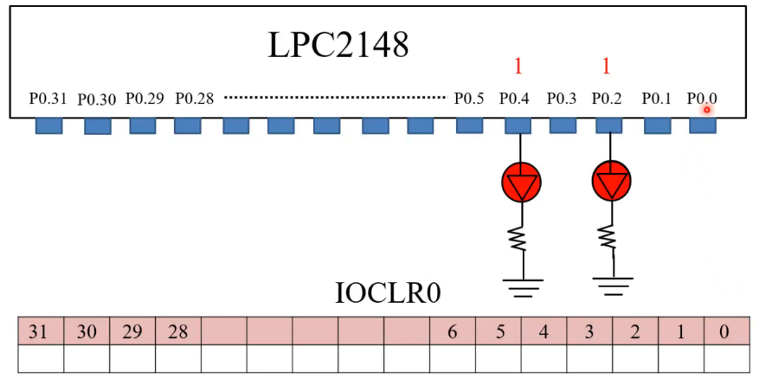
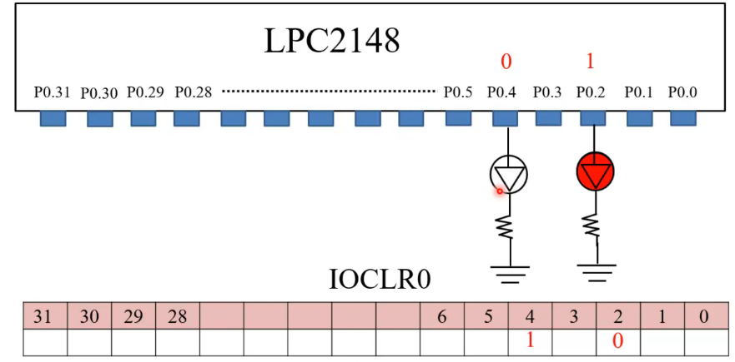
IOCLR
26

Slide 27
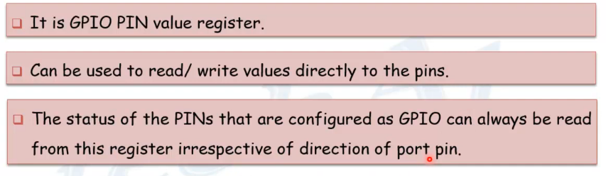
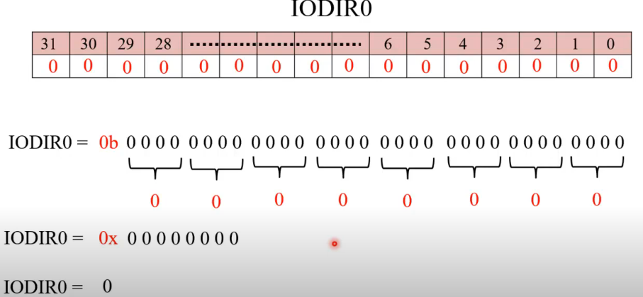
IOPIN
27

Slide 28
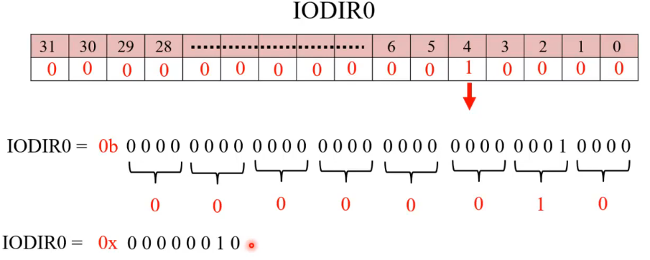
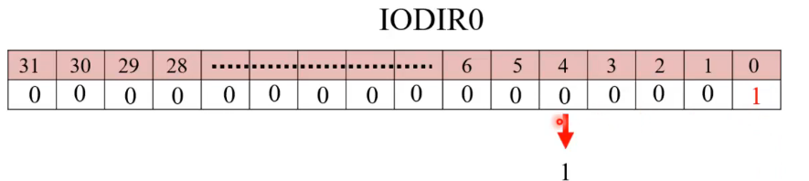
IODIR
28

Slide 29
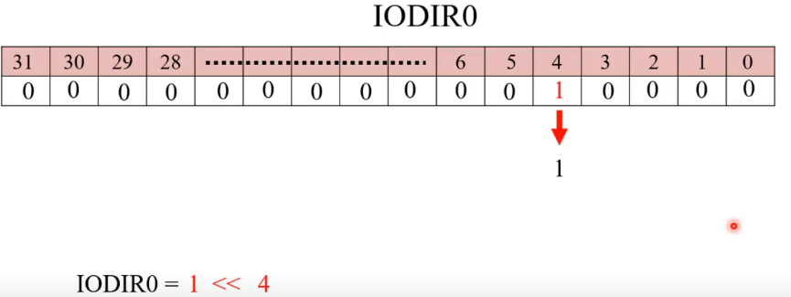
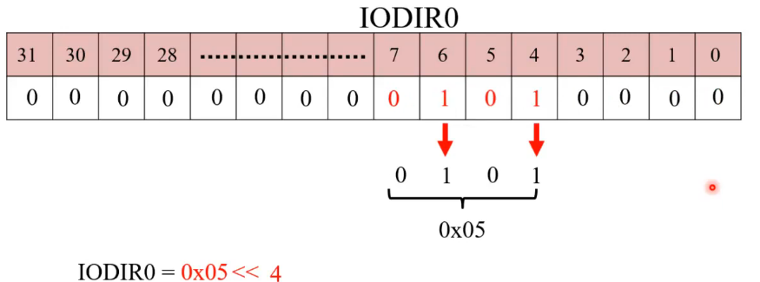
IODIR
29

Slide 30
Registers
LPC2148 is a 32-bit microcontroller, the length of all the registers mentioned is also 32-bits.
Each bit in the above-mentioned registers is directly linked to the corresponding pin in the microcontroller i.e. bit ‘a’ in IO0SET corresponds to Pin ‘a’ in the PORT0.
Registers in LPC2148 follow Big Endian format i.e. bit 0 is the LSB on the extreme right of the register and bit 31 is the MSB on the extreme left of the register.
Another important note is that when reset, all the pins are set as GPIO pins and the direction of each pin is set as Input.
30

Slide 31
Simple C programs for application with LED
#include "lpc214x.h" // Include LPC2148 header file
#define LED_PORT IO0PIN // Define LED to Port1
#define LED_DIR IO0DIR // Define Port1 direction register
void delayMs(unsigned int x);
int main()
{
PINSEL0 = 0x00000000; // Define port lines as GPIO
LED_DIR |= 0x00000100; // Define LED pin as O/P
LED_PORT |= 0x00000000; // Turn off the LED initially
while(1) // Loop forever
{
LED_PORT |= 0x00000100; // Turn ON LED
delayMs(1000); // 1 second delay
LED_PORT &= 0x00000000; // Turn OFF LED
delayMs(1000); // 1 second delay
}
}
31

Slide 32
Simple C programs for application with LED
void delayMs(unsigned int x)
{
unsigned int j;
for(;x>0;x--)
for(j=0; j<0x1FFF; j++);
}
32

Slide 33
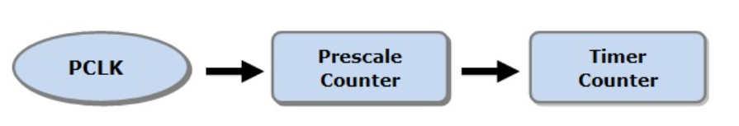
Timers
The LPC2148 has two functionally identical general-purpose timers: Timer0 and Timer1.
These both timers are 32-bit along with 32-bit prescaler.
Timer allows us to generate precise time delay.
How Timers in LPC2148 ARM7 Microcontroller Works?
33

Slide 34
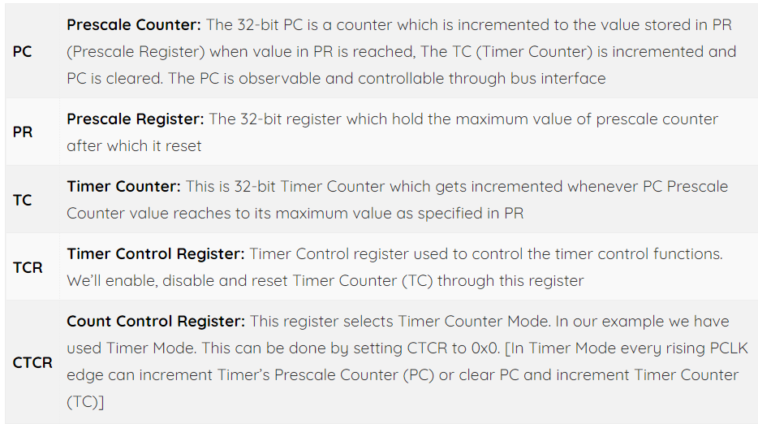
Timers
TIMER REGISTERS in LPC2148
34

Slide 35
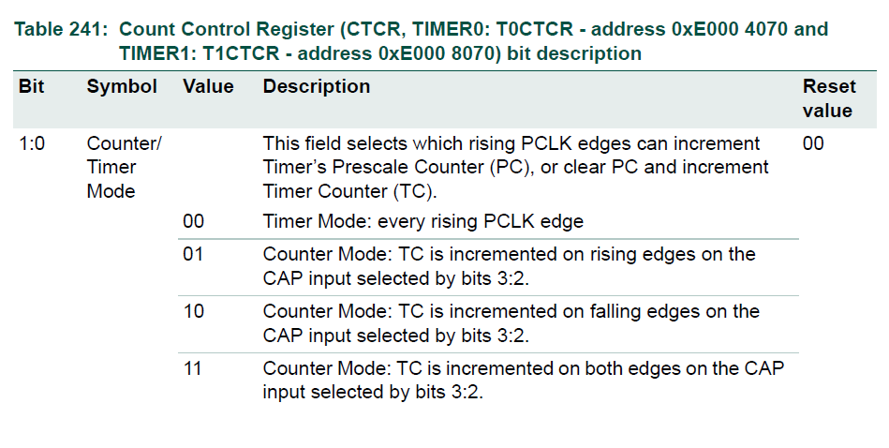
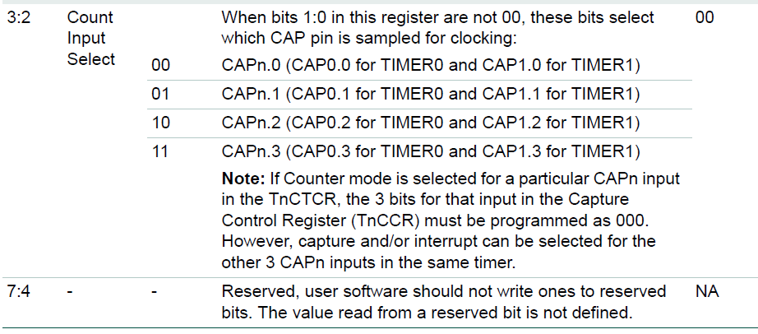
Timers
TIMER REGISTERS in LPC2148
35

Slide 36
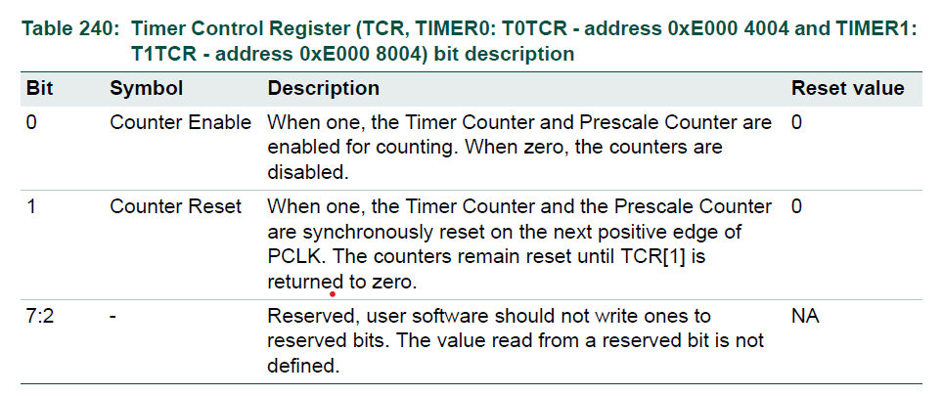
Timers
TIMER REGISTERS in LPC2148
36

Slide 37
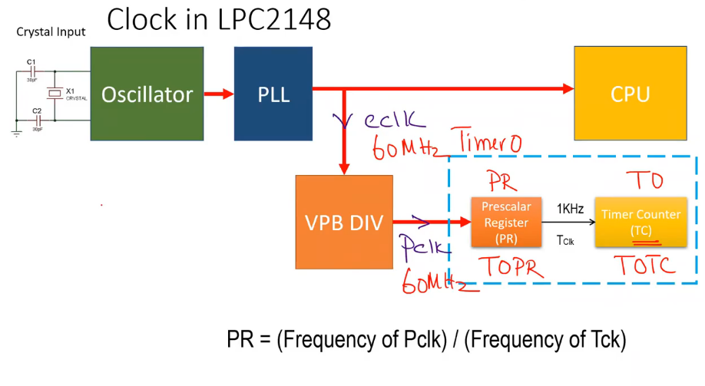
Timers
TIMER REGISTERS in LPC2148
37

Slide 38
Timers
Before we jump start on writing program. We have to understand setting up of Timer Registers or you can say sequence of operations. We’ll be following along:
Setup Timer T0 into Timer Mode (T0CTCR = 0x0)
Setup Prescale value in T0PR (in our case 59999)
Reset Timer by setting (T0TCR = 0x02)
Setup T0TCR to 0x01 to Enable Timer when needed
Reset T0TCR to 0x00 to Disable Timer when needed
You may be wondering, why we have set Prescale Value to 59,999. Let’s calculate prescale count value:
Required Time 1 Second = 1/1000 milliseconds = 0.001 seconds (Resolution=1 ms)
PRESCALE COUNT= (60 MHz x Required Time Delay) – 1 = (60000000 x 0.001) – 1 = 59999 Hence the delay required for TC to increment by 1 will be 1 ms.
38

Slide 39
Timers
In this code LED will Blink with a 1-second delay. I’m using Timer 0 in this code. LEDs are connected to Port 0.
#include<lpc214x.h>
void delay(unsigned int z);
void pll();
int main(void)
{
IO0DIR=0xffffffff;
pll(); //Fosc=12Mhz,CCLK=60Mhz,PCLK=60MHz
while(1) {
IO0SET=0xffffffff;
delay(1000); //1sec delay
IO0CLR=0xffffffff;
delay(1000); //1sec delay
}
}

Slide 40
Timers
void pll() //Fosc=12Mhz,CCLK=60Mhz,PCLK=60MHz
{
PLL0CON=0x01;
PLL0CFG=0x24;
PLL0FEED=0xaa;
PLL0FEED=0x55;
while(!(PLL0STAT&(1<<10)));
PLL0CON=0x03;
PLL0FEED=0xaa;
PLL0FEED=0x55;
VPBDIV=0x01;
}

Slide 41
Timers
void delay(unsigned int z)
{
T0CTCR=0x0; //Select Timer Mode
T0TCR=0x00; //Timer off
T0PR=59999; //Prescaler value for 1ms
T0TCR=0x02; //Timer reset
T0TCR=0x01; //Timer ON
while(T0TC<z);
T0TCR=0x00; //Timer OFF
T0TC=0; //Clear the TC value. This is Optional.
}

Slide 42
LCD interfacing
LCDs (Liquid Crystal Displays) are used for displaying status or parameters in embedded systems.
A 16×2 LCD means it can display 16 characters per line and there are 2 such lines. In this LCD each character is displayed in a 5×7 pixel matrix.
LCD 16x2 is 16 pin device which has 8 data pins (D0-D7) and 3 control pins (RS, RW, EN). The remaining 5 pins are for supply and backlight for the LCD.
The control pins help us configure the LCD in command mode or data mode. They also help configure read mode or write mode and when to read or write.

Slide 43
LCD interfacing
The command register stores the command instructions given to the LCD.
A command is an instruction given to LCD to do a predefined task like initializing it, clearing its screen, setting the cursor position, controlling the display, etc.
The data register stores the data to be displayed on the LCD. The data is the ASCII value of the character to be displayed on the LCD.
LCD 16x2 can be used in 4-bit mode or 8-bit mode depending on the requirement of the application

Slide 44
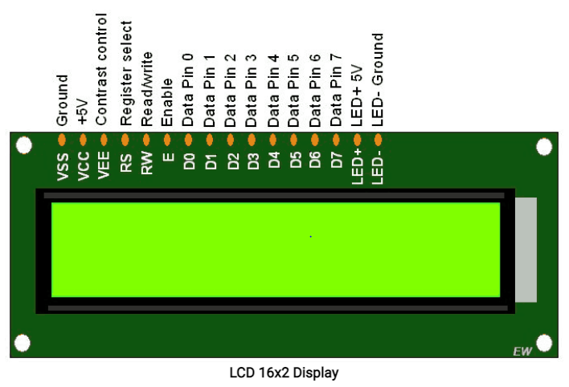
LCD interfacing

Slide 45
LCD interfacing
Pin No | Function | Name
1 | Ground (0V) | Ground
2 | Supply voltage; 5V (4.7V – 5.3V) | Vcc
3 | Contrast adjustment; through a variable resistor | V_{EE}
4 | Selects command register when low; and data register when high | Register Select
5 | Low to write to the register; High to read from the register | Read/write
6 | Sends data to data pins when a high to low pulse is given | Enable
7 | 8-bit data pins | DB0
8 |  | DB1
9 |  | DB2
10 |  | DB3
11 |  | DB4
12 |  | DB5
13 |  | DB6
14 |  | DB7
15 | Backlight V_{CC} (5V) | Led+
16 | Backlight Ground (0V) | Led-

Slide 46
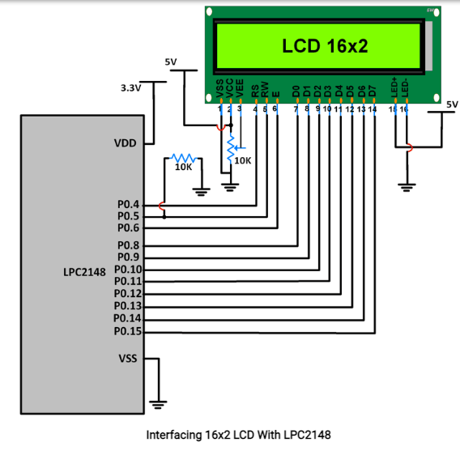
LCD interfacing
LCD Data pins D0-D7 are connected to pins P0.8-P0.15 of Port 0
LCD control pins RS, RW and EN are connected to P0.4, P0.5 P0.6 respectively.

Slide 47
LCD interfacing
Command Write Function
For command mode, RS = 0.
RW = 0 for write.
High to low EN pulse of minimum 450ns high pulse width.
Data Write Function (Single Character)
For data mode, RS = 1.
RW = 0 for write.
High to low EN pulse of minimum 450ns high pulse width.
Data Write Function(String)
For data mode, RS = 1.
RW = 0 for write.
High to low EN pulse of minimum 450ns high pulse width.

Slide 48
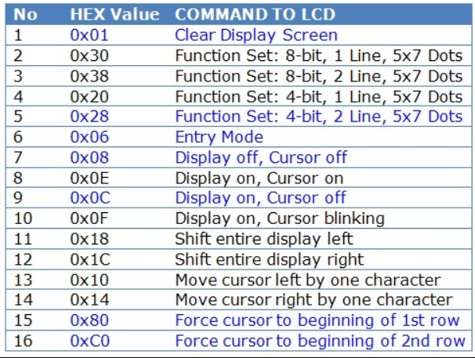
LCD interfacing

Slide 49
LCD interfacing Program
#include <lpc214x.h>
#include <stdint.h>
#include <stdlib.h>
#include <stdio.h>
void delay_ms(uint16_t j) /* Function for delay in milliseconds */
{
unsigned int16_t x,i;
for(i=0;i<j;i++)
{
for(x=0; x<6000; x++); /* loop to generate 1 millisecond delay with Cclk = 60MHz */
}
}

Slide 50
LCD interfacing Program
int main(void)
{
int j;
j = 0;
char val_j[3];
LCD_INIT();
LCD_STRING("Good Day! hello");
LCD_CMD(0xC0);
LCD_STRING("Val of j is:");
for(j=0;j<10;j++)
{
sprintf(val_j,"%d ",j);
LCD_STRING(val_j);
delay_ms(100);
LCD_CMD(0xC0);
}
return 0;
}

Slide 51
LCD interfacing Program
void LCD_CMD(char command)
{
IO0PIN = ( (IO0PIN & 0xFFFF00FF) | (command<<8) );
IO0SET = 0x00000040; /* EN = 1 */
IO0CLR = 0x00000030; /* RS = 0, RW = 0 */
delay_ms(2);
IO0CLR = 0x00000040; /* EN = 0, RS and RW unchanged(i.e. RS = RW = 0) */
delay_ms(5);
}

Slide 52
LCD interfacing Program
void LCD_INIT(void)
{
IO0DIR = 0x0000FFF0; /* P0.8 to P0.15 LCD Data. P0.4,5,6 as RS RW and EN */
delay_ms(20);
LCD_CMD(0x38); /* Initialize lcd */
LCD_CMD(0x0C); /* Display on cursor off */
LCD_CMD(0x06); /* Auto increment cursor */
LCD_CMD(0x01); /* Display clear */
LCD_CMD(0x80); /* First line first position */
}

Slide 53
LCD interfacing Program
void LCD_STRING (char* msg)
{
uint8_t i=0;
while(msg[i]!=0)
{
IO0PIN = ( (IO0PIN & 0xFFFF00FF) | (msg[i]<<8) );
IO0SET = 0x00000050; /* RS = 1, , EN = 1 */
IO0CLR = 0x00000020; /* RW = 0 */
delay_ms(2);
IO0CLR = 0x00000040; /* EN = 0, RS and RW unchanged(i.e. RS = 1, RW = 0) */
delay_ms(5);
i++;
}
}

Slide 54
LCD interfacing Program
void LCD_CHAR (char msg)
{
IO0PIN = ( (IO0PIN & 0xFFFF00FF) | (msg<<8) );
IO0SET = 0x00000050; /* RS = 1, , EN = 1 */
IO0CLR = 0x00000020; /* RW = 0 */
delay_ms(2);
IO0CLR = 0x00000040; /* EN = 0, RS and RW unchanged(i.e. RS = 1, RW = 0) */
delay_ms(5);
}

Slide 55
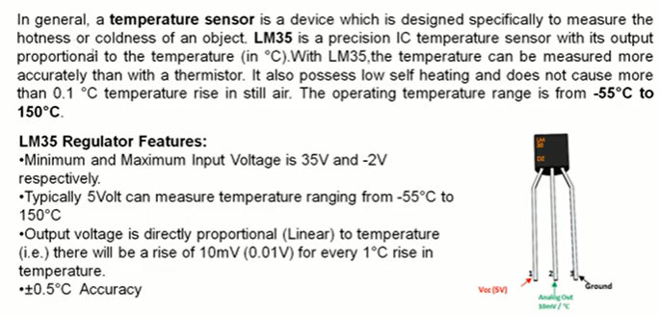
LM35 Temperature Sensor

Slide 56
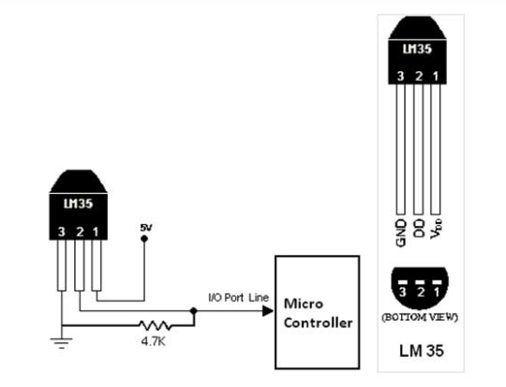
LM35 Temperature sensor
56

Slide 57
LM35 Temperature sensor
The LM35 series are precision integrated-circuit temperature sensors, whose output voltage is linearly proportional to the Celsius (Centigrade) temperature. The output of sensor converted to digital that easy connecting with microcontroller.
The third pin is connected to GND, the first pin is connected to VCC & the second pin is connected to the Microcontroller input. Just use single PIN female to female wire to connect with the leads of LM35 temperature sensor. So when the temperature is sensing, it give the sensor reading to controller.
57

Slide 58
ADC (Analog to Digital Converter)
Analog to Digital Converter(ADC) is used to convert analog signal into digital form. LPC2148 has two inbuilt 10-bit ADC i.e. ADC0 & ADC1.
ADC0 has 6 channels &ADC1 has 8 channels.
Hence, we can connect 6 distinct types of input analog signals to ADC0 and 8 distinct types of input analog signals to ADC1.
ADCs in LPC2148 use Successive Approximation technique to convert analog signal into digital form.
This Successive Approximation process requires a clock less than or equal to 4.5 MHz. We can adjust this clock using clock divider settings.
Both ADCs in LCP2148 convert analog signals in the range of 0V to VREF (typically 3V)

Slide 59
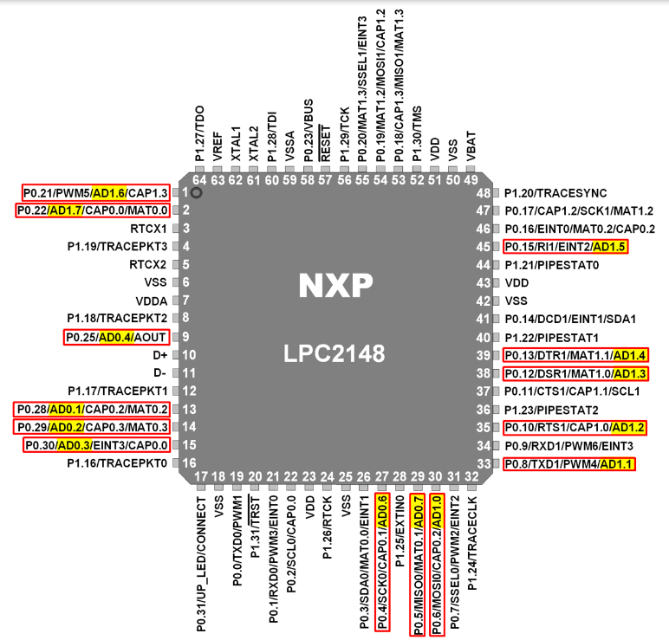
ADC (Analog to Digital Converter)

Slide 60
ADC (Analog to Digital Converter)
AD0.1:4, AD0.6:7 & AD1.7:0 (Analog Inputs)
These are Analog input pins of ADC.
If ADC is used, signal level on analog pins must not be above the level of VDDA (7th Pin) otherwise, ADC readings will be invalid.
If ADC is not used, then the pins can be used as 5V tolerant digital I/O pins.
VREF (Voltage Reference)
Provide Voltage Reference for ADC.
VDDA& VSSA (Analog Power and Ground)
These are the power and ground pins for ADC. These should be same as VDD & VSS.

Slide 61
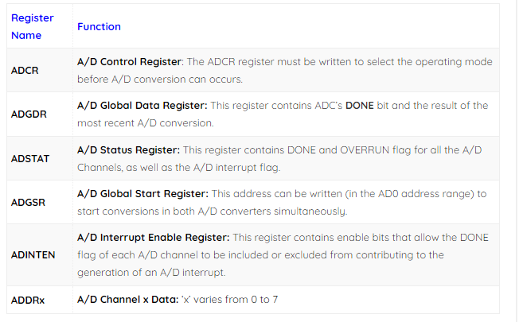
ADC (Analog to Digital Converter)
ADC0 Registers
ADC registers which are used to control and monitors the ADC operation.

Slide 62
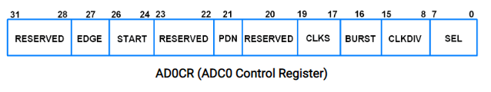
ADC (Analog to Digital Converter)
ADC0 Registers
ADC registers which are used to control and monitors the ADC operation.

Slide 63
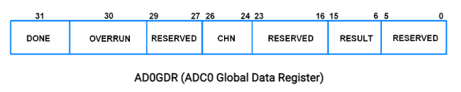
ADC (Analog to Digital Converter)
ADC0 Registers
ADC registers which are used to control and monitors the ADC operation.

Slide 64
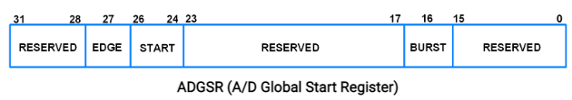
ADC (Analog to Digital Converter)
ADC0 Registers
ADC registers which are used to control and monitors the ADC operation.

Slide 65
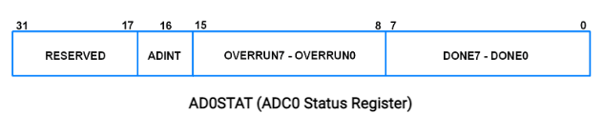
ADC (Analog to Digital Converter)
ADC0 Registers
ADC registers which are used to control and monitors the ADC operation.

Slide 66
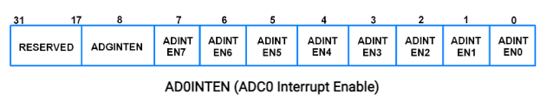
ADC (Analog to Digital Converter)
ADC0 Registers
ADC registers which are used to control and monitors the ADC operation.

Slide 67
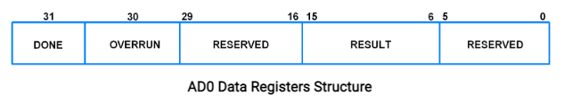
ADC (Analog to Digital Converter)
ADC0 Registers
ADC registers which are used to control and monitors the ADC operation.

Slide 68
ADC (Analog to Digital Converter)
Steps for Analog to Digital Conversion
Configure the ADxCR (ADC Control Register) according to the need of application.
Start ADC conversion by writing appropriate value to START bits in ADxCR. (Example, writing 001 to START bits of the register 26:24, conversion is started immediately).
Monitor the DONE bit (bit number 31) of the corresponding ADxDRy (ADC Data Register) till it changes from 0 to 1. This signals completion of conversion. We can also monitor DONE bit of ADGSR or the DONE bit corresponding to the ADC channel in the ADCxSTAT register.
Read the ADC result from the corresponding ADC Data Register. ADxDRy. E.g. AD0DR1 contains ADC result of channel 1 of ADC0.

